Slide 1
Simplifying recurring trips Improving convenience and utilization Team Banh Mi

Slide 2
Our approach

Slide 3
Our approach
low rate of utilization
which demand is not yet served?

Slide 4
Our approach
low rate of utilization
which demand is not yet served?
user behavior
Providing incentives

Slide 5



Feature recurring bookings
Never forget to book
Unlock from lockscreen via notification
Discounts
Reminder the evening before

Slide 6
Feature recurring bookings
Financial incentives for users
Planning safety for everyone
Higher utilization rate and cost coverage for the landlord

Slide 7



Feature Gamification
Eco-friendliness
rewards and progress for good user behaviour

Slide 8
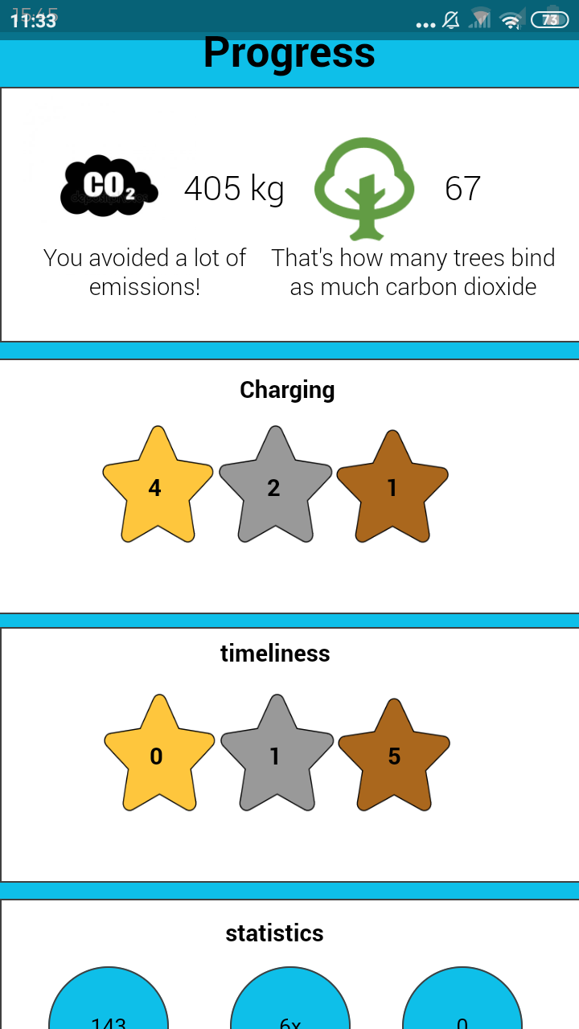
Clickable mockup
Implementation WIP…

Slide 9
Presentation of Code
GUI (Kivy)
Bottle
API
Client
Server
Database
Hack: Pickle
Database

Slide 10
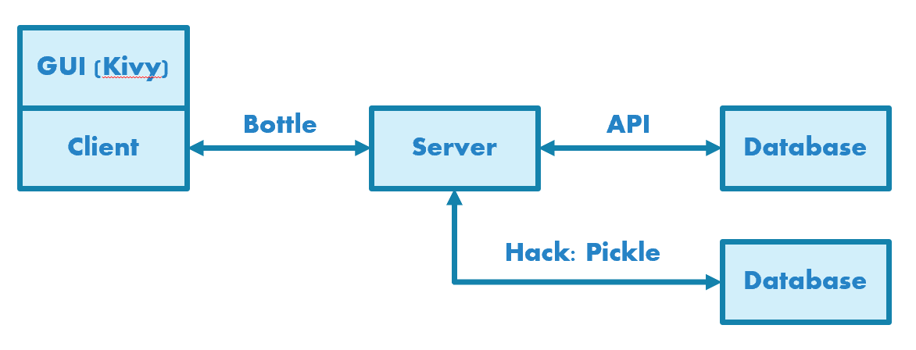
Presentation of Code
Pros & Cons of our solution
Key learnings
Easy to implement (in principle)
Many nice libraries for python
Not very innovative
More experience with application and frontend development needed
Scrum is fun but probably works better with actual developers

